Slide 1


End to End Speech Recognition With Transformers
Through Translation Systems
- Master Final Thesis -
Master’s Degree IASD: Artificial Intelligence, Systems, Data
Laurène Hanna Bouskila
Under the supervision of:
Charles Sutton
Chief Technology Officer at DataScientest.com

Slide 2
Table of Contents
Internship Description
Speech Recognition: Introduction and Core Concepts
The VoiceGlass Project
Translation Systems and Transformers
Applications and Openings

Slide 3
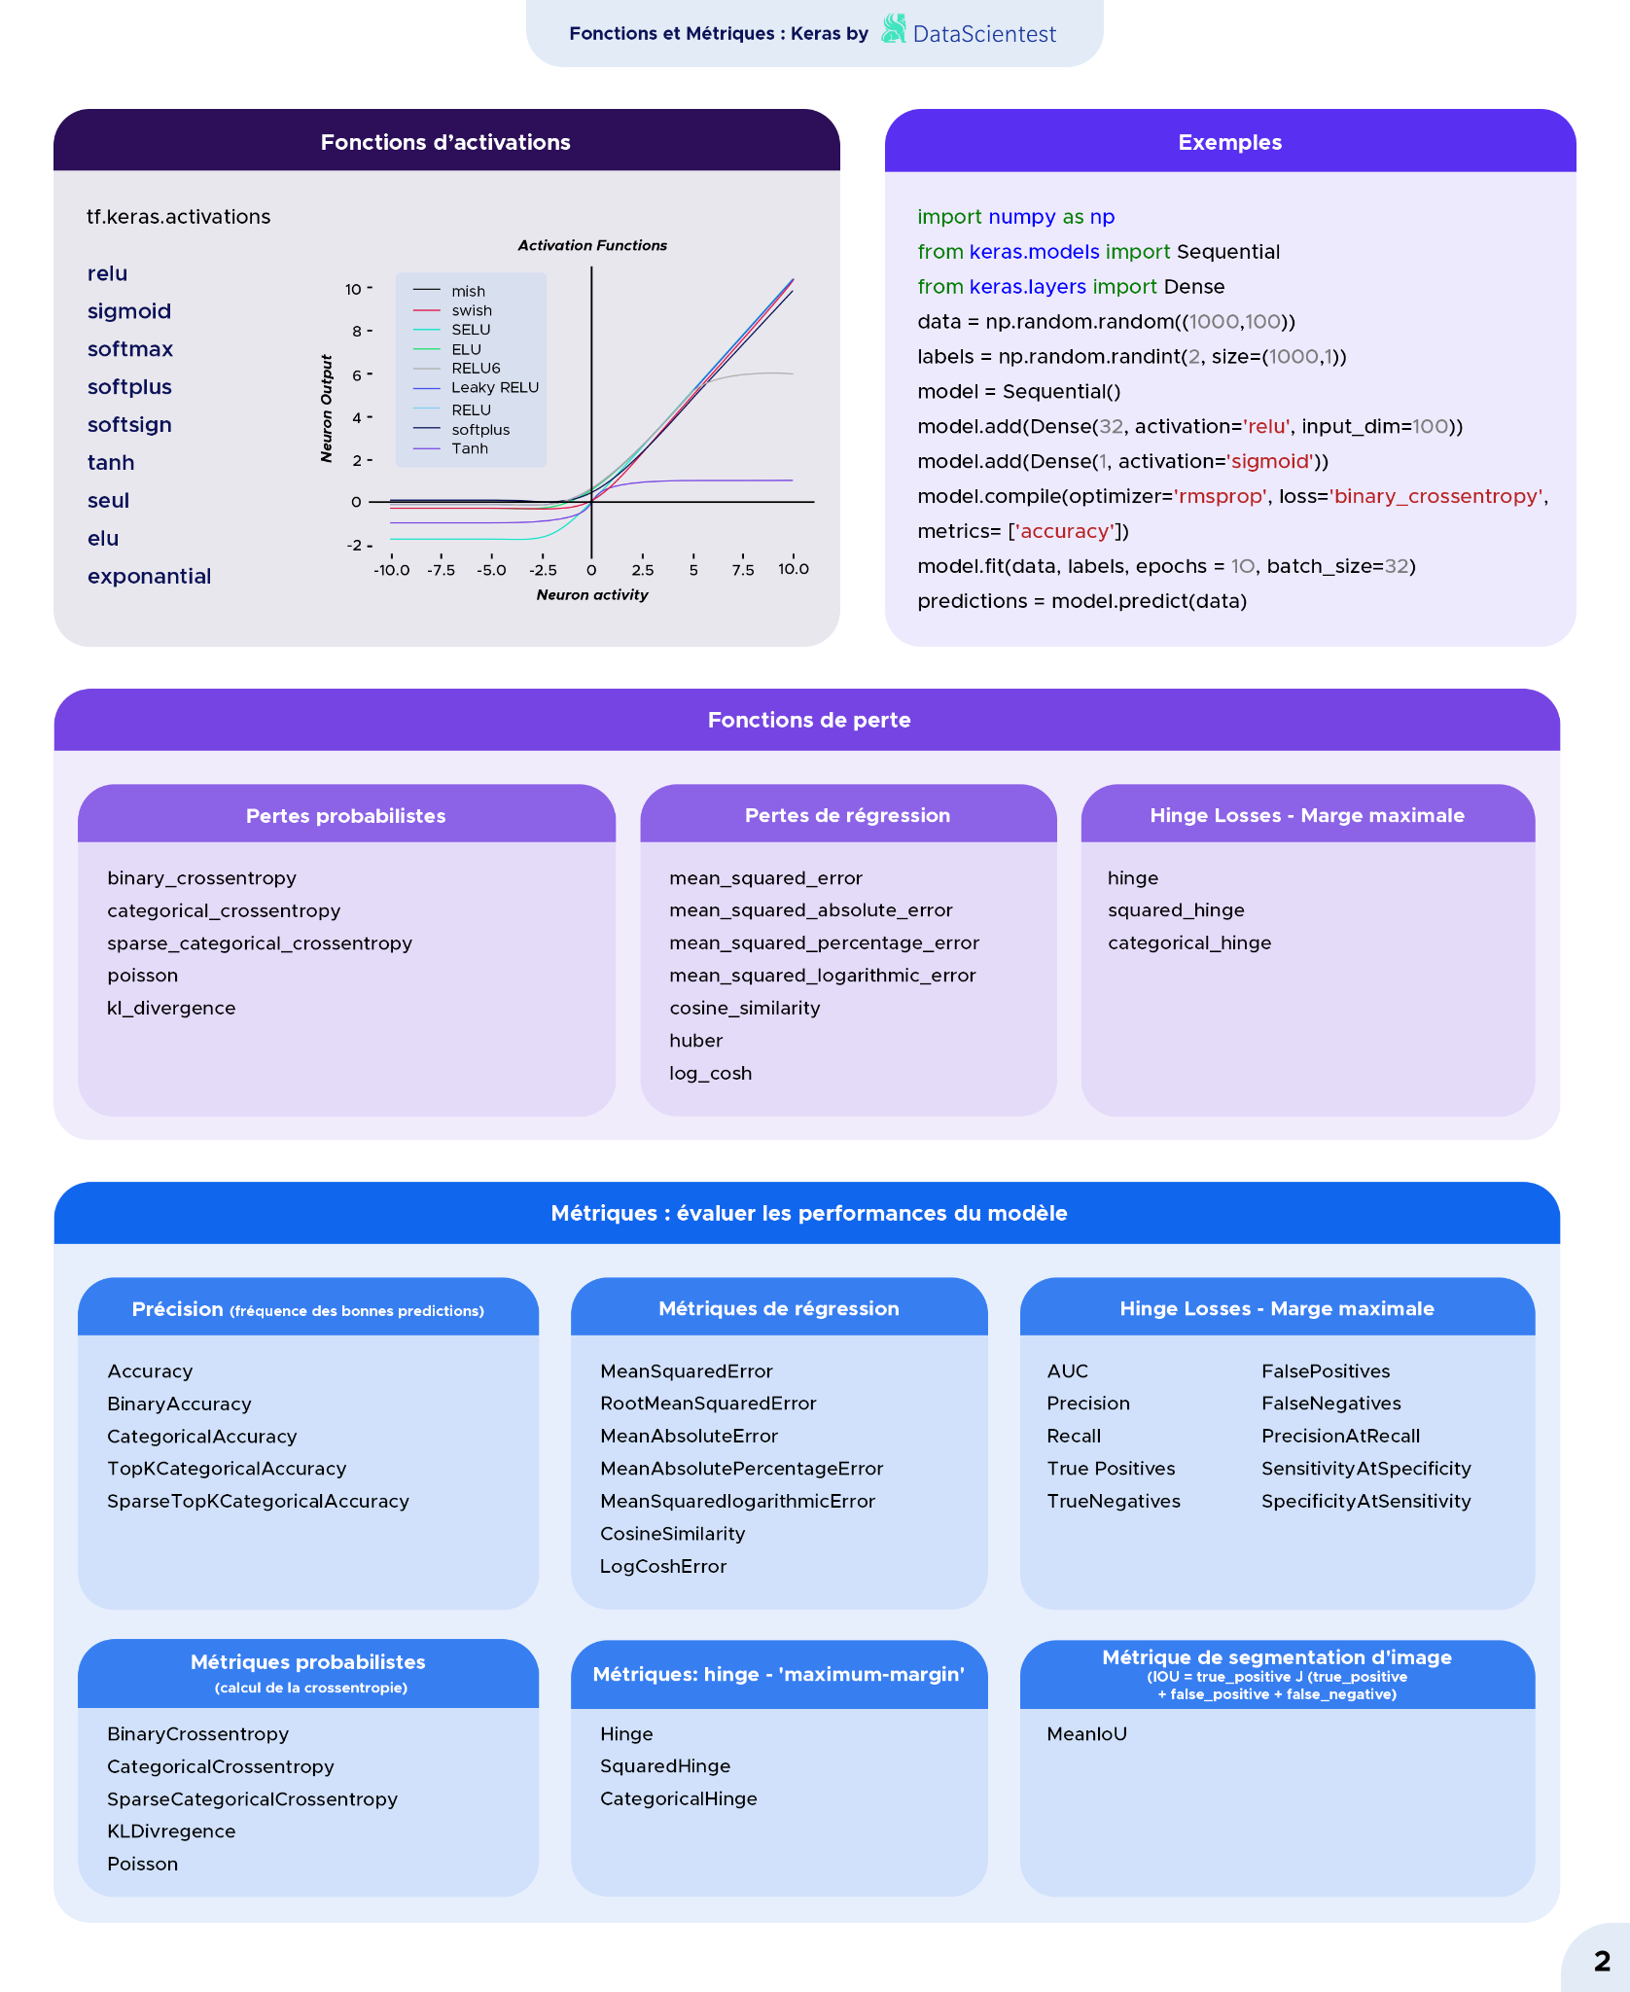
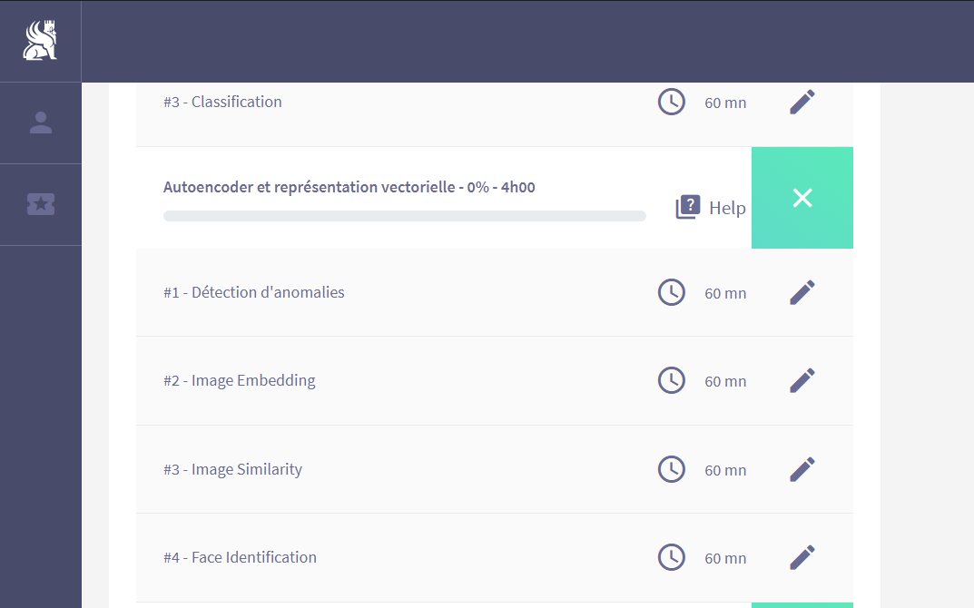
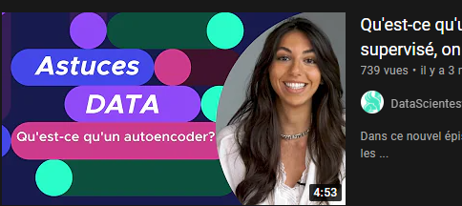
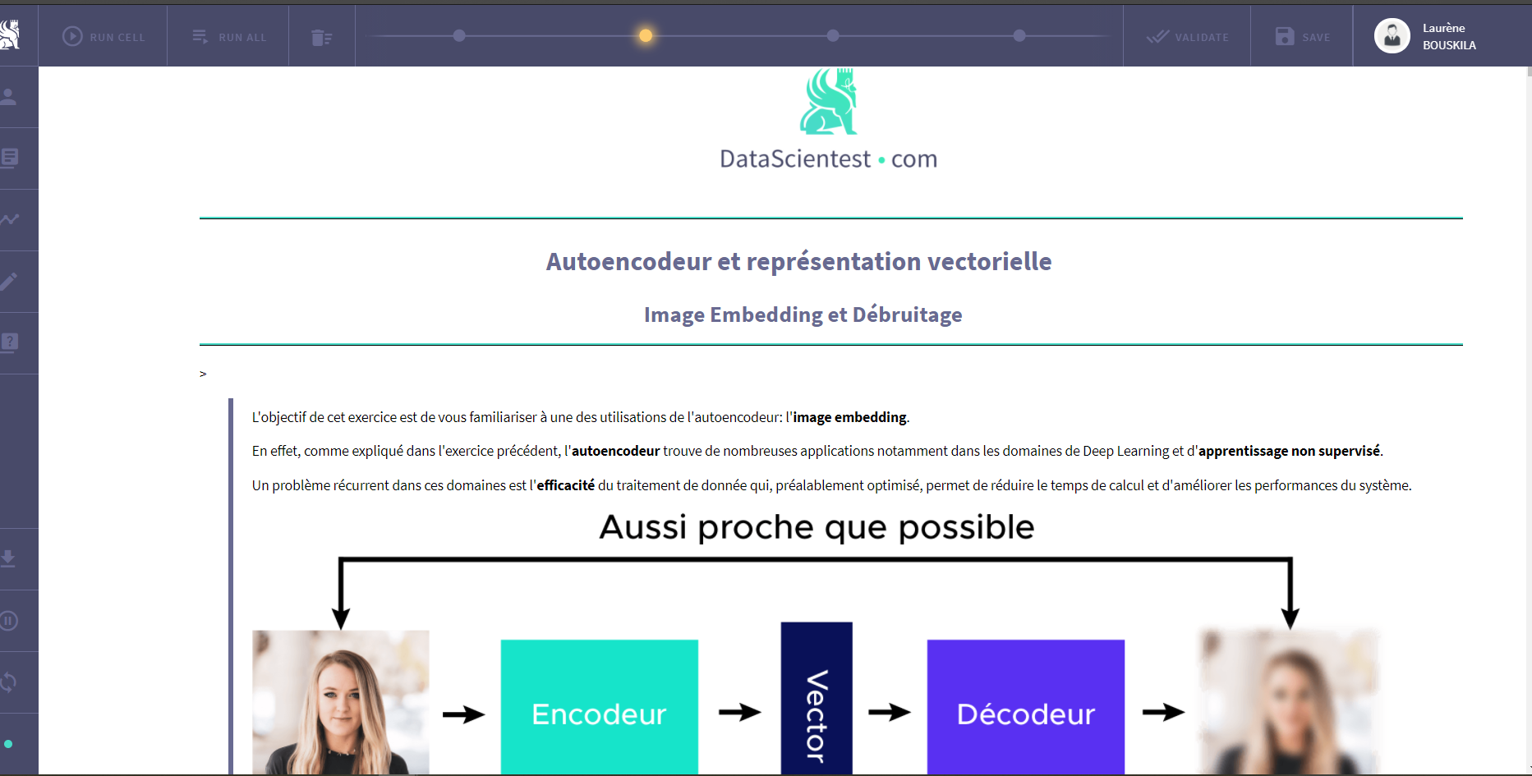
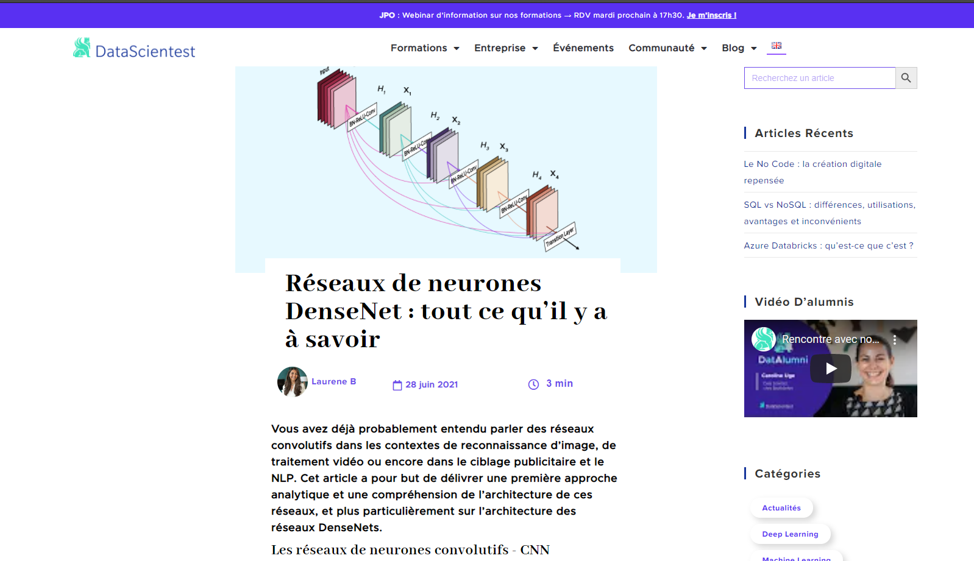
Internship Description
Content Development
Cheat Sheets
Module Development
Videos
Articles and Research Papers

Slide 4
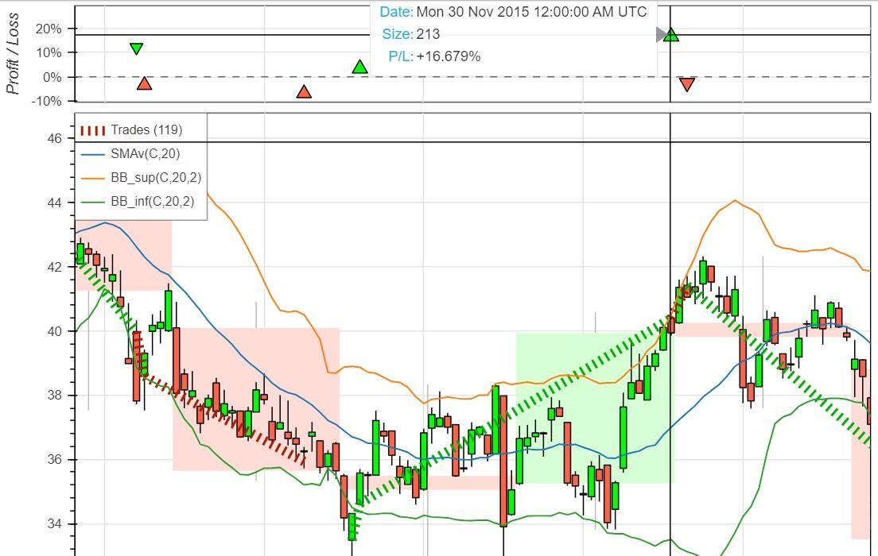
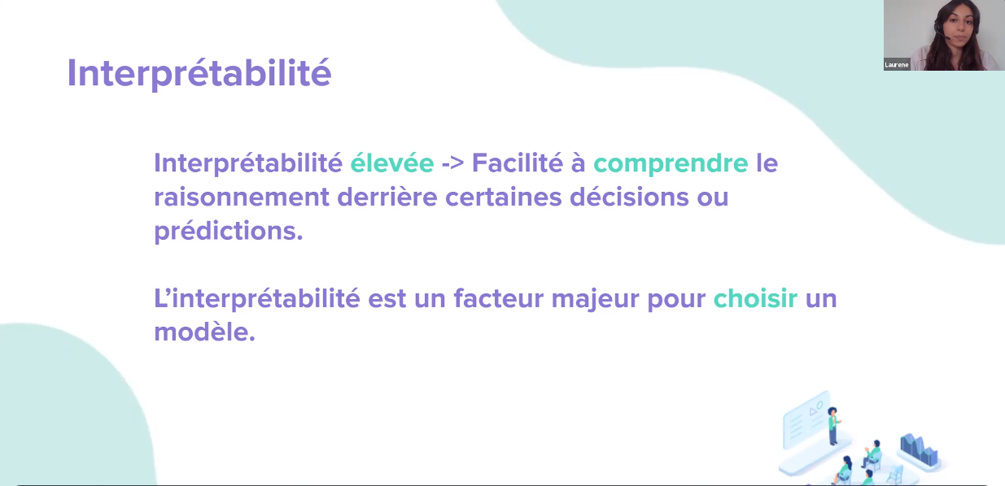
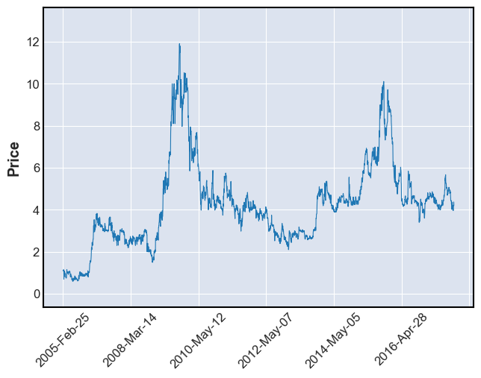
Internship Description
Teaching
Project Mentoring
Masterclasses

Slide 5

Speech Recognition: Introduction and Core Concepts

Slide 6
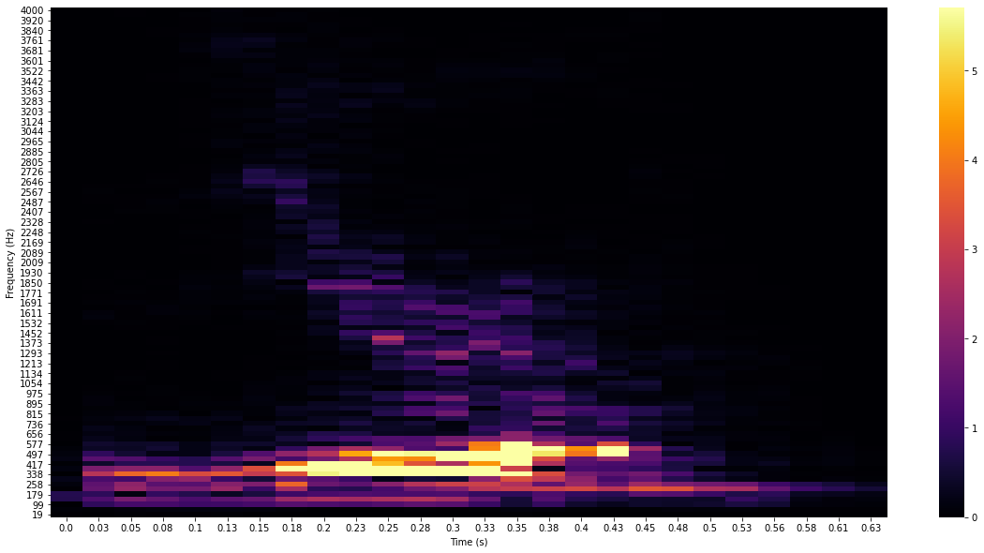
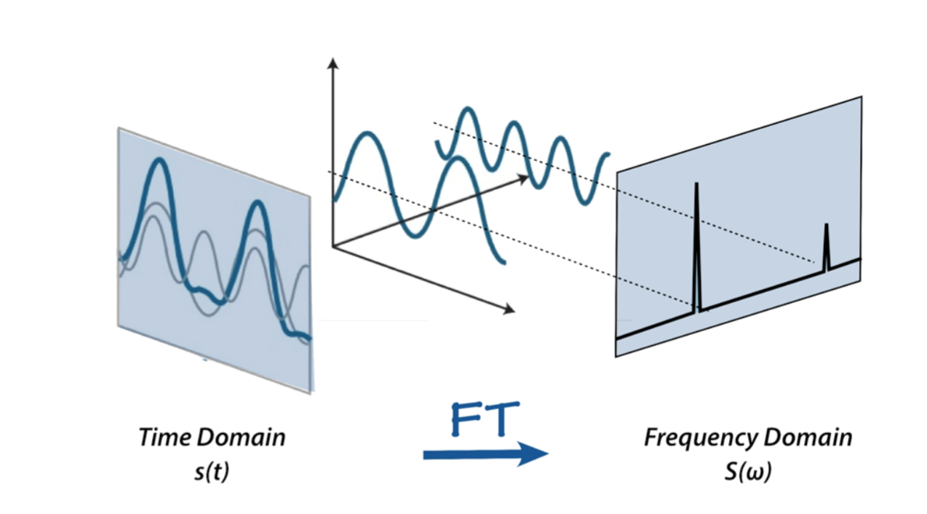
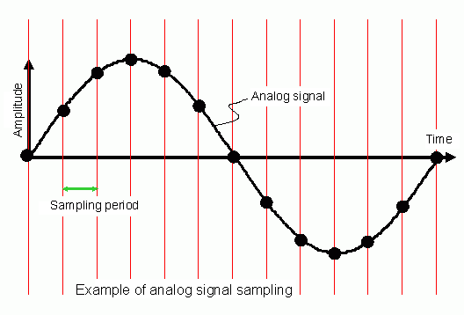
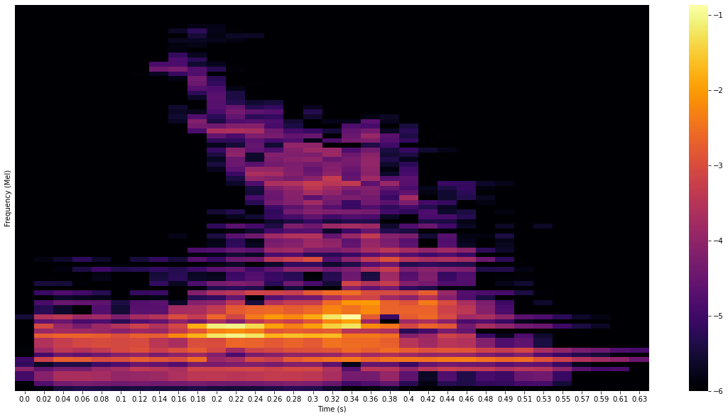
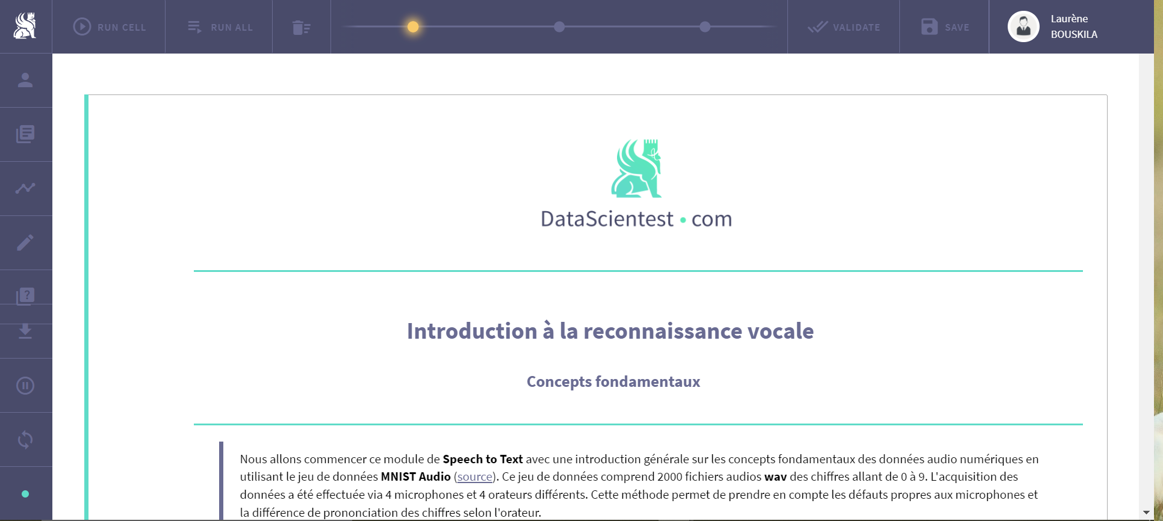
Spectrogram:
Fourier Transform:
Sampling Frequency:
Mel Scale:
Core Concept Module Development

Slide 7

The VoiceGlass project https://studio.datascientest.com/project/voiceglass/ Malik ALY MARECAR & Lamia BOUGARA

Slide 8
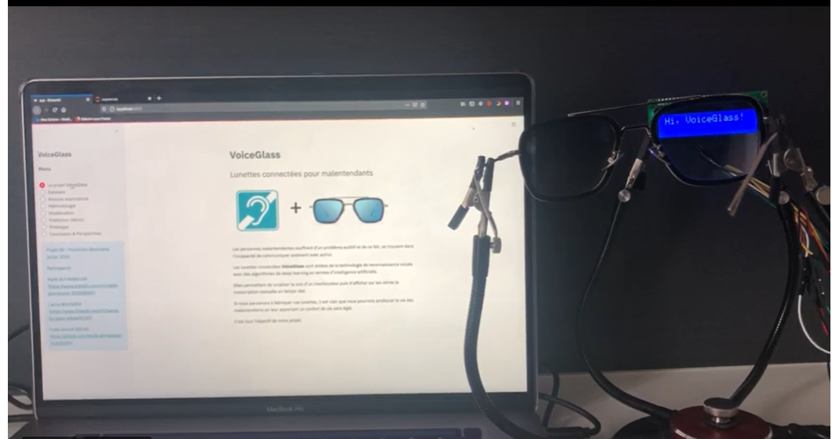
Voice Recognition
Substantial Solution for deaf people
Sensing the interlocutor voice
Convert the audio signal into a text transcription
Demo: https://www.youtube.com/watch?v=n8WyOLND0jk&t=11s

Slide 9
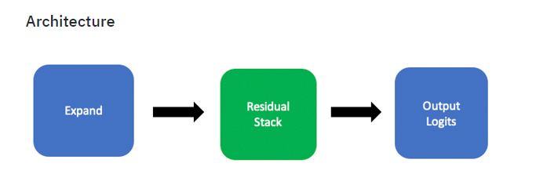
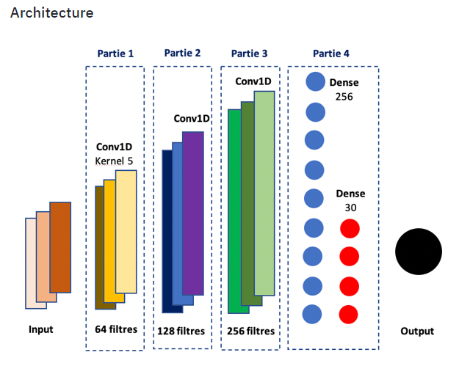
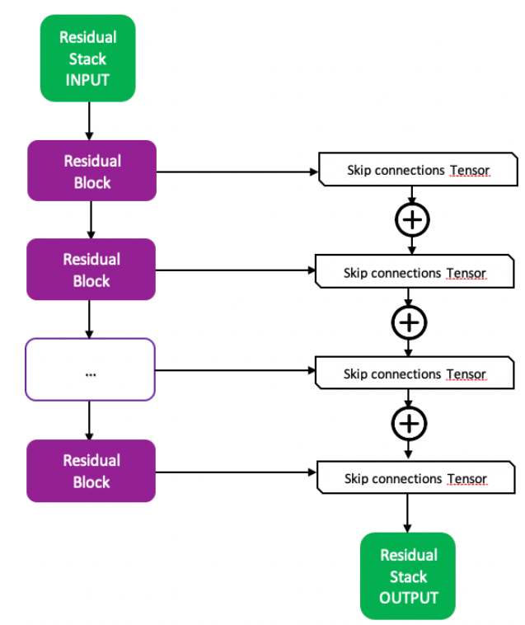
Modelisation: Single word vs Multiple words

Slide 10

Translation Systems

Slide 11
Implementation
Several Approaches
Naive and probabilistic approach
Word2Vec and word by word translation
Seq2Seq translation
Transformers

Slide 12
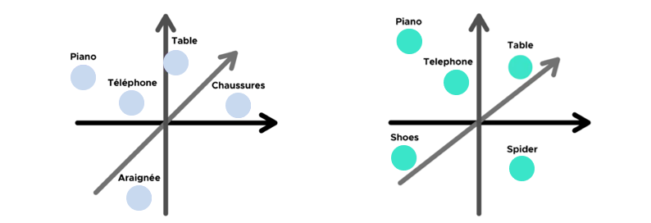
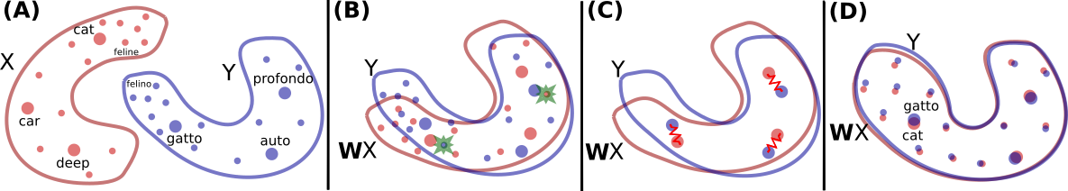
Machine Translation principles

Slide 13

Naive and probabilistic approach
Hypothesis: A specific word and its translation occupy approximately the same place in the sentences
Strategy:
Elaborate a translation window which encapsulates in translation word candidates
Establish a probability for each one of them by going over the whole dataset
Save only the words with a probability above a certain threshold
Retain only the most probable candidate
Improvements on the analysis of the window size, the suppression of problematic words, analysis on the threshold performance influence
Conclusion: As can be expected, the results are pretty poor ()→ which leads us to another strategy (46%)

Slide 14
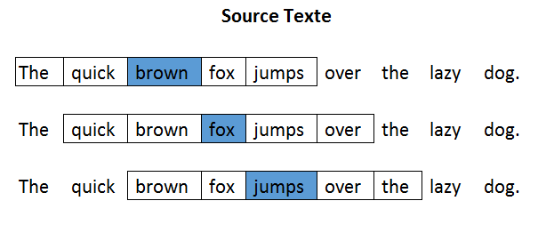
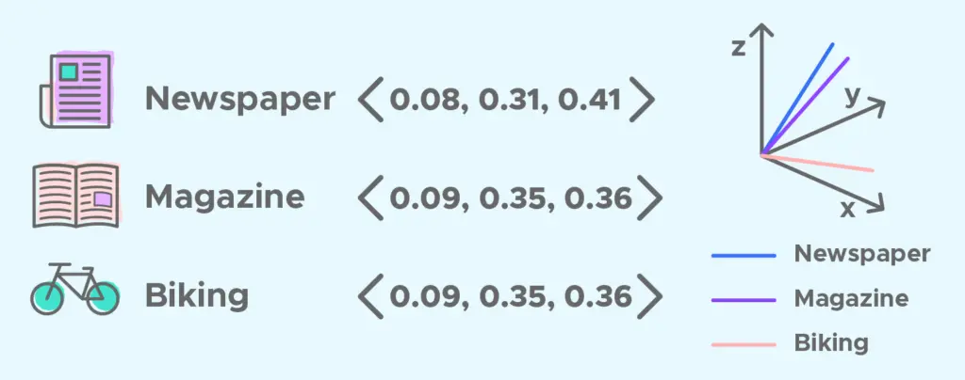
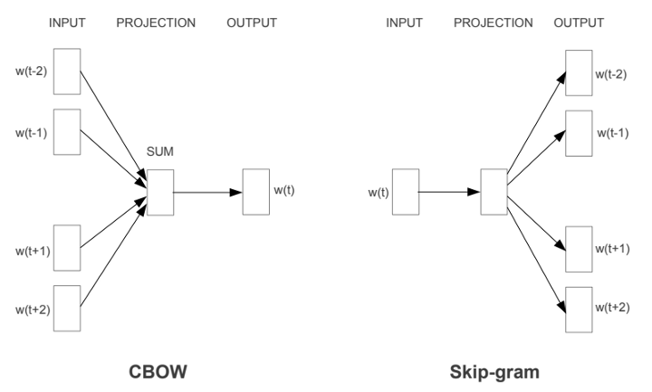

2. Word by word translation: Word2Vec

Slide 15
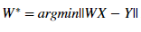
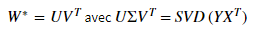
2. Word by word translation: Learning the rotation matrix W
Strategy: Learn W on the transparent words between the two corpuses
Build a dictionary that only keeps transparent words in both corpuses
Define from it two embedding matrices (for the 2 languages) X and Y
Problem type: Minimization of the function ||WX-Y||
→ The more similar the embedding space structures, the better the performances will be for this method.
Resolution: By Singular Value Decomposition
Under the constraint that W is orthogonal
Spectral theorem generalization
Conclusion: performance 59.22%

Slide 16
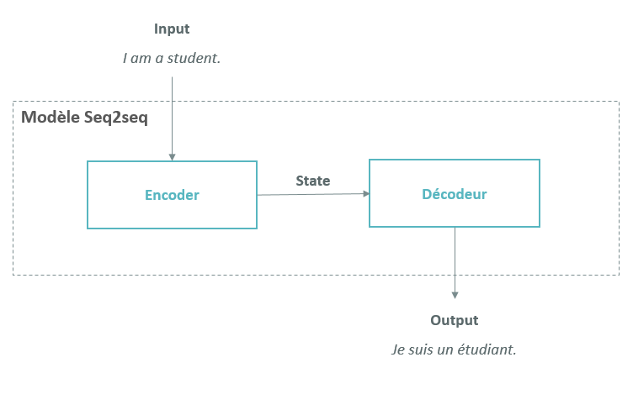
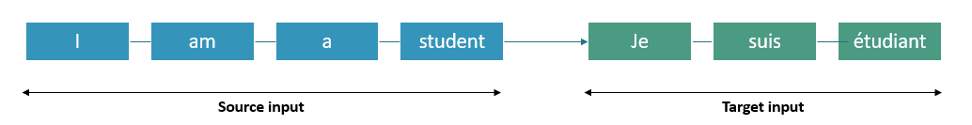
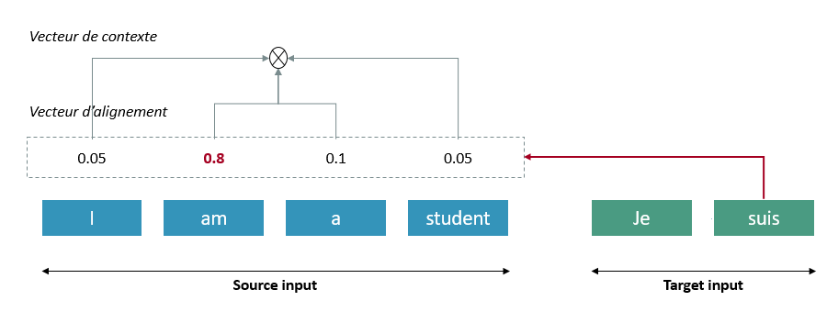
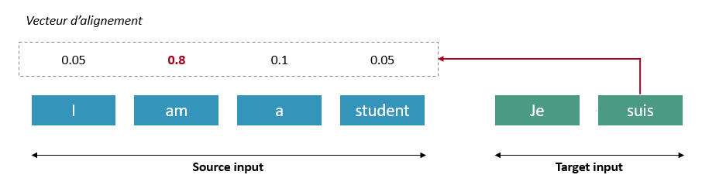
3. Seq2Seq
Attention Mechanism
Context Vector
Alignment vector

Slide 17
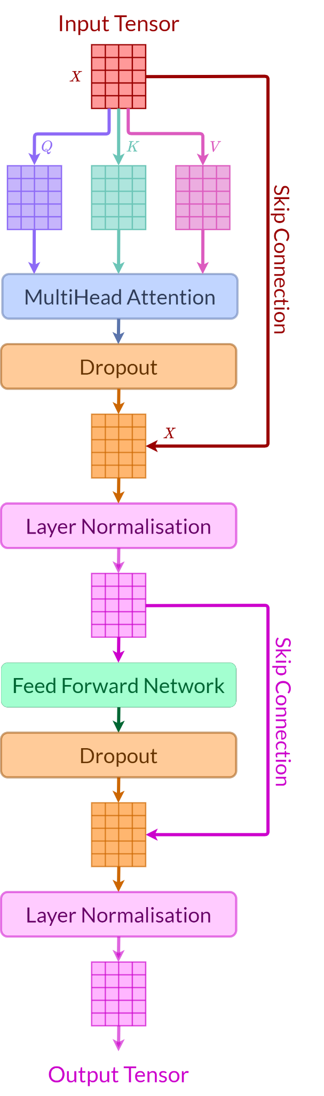
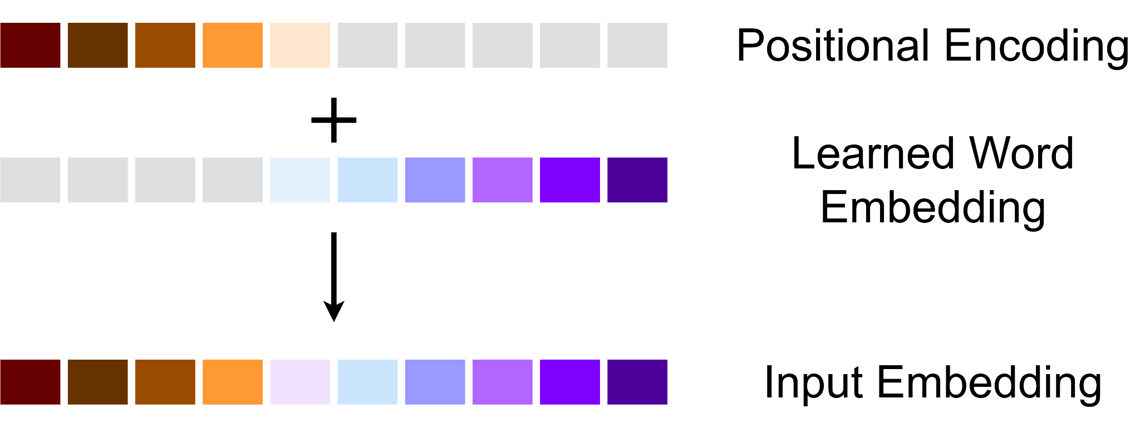
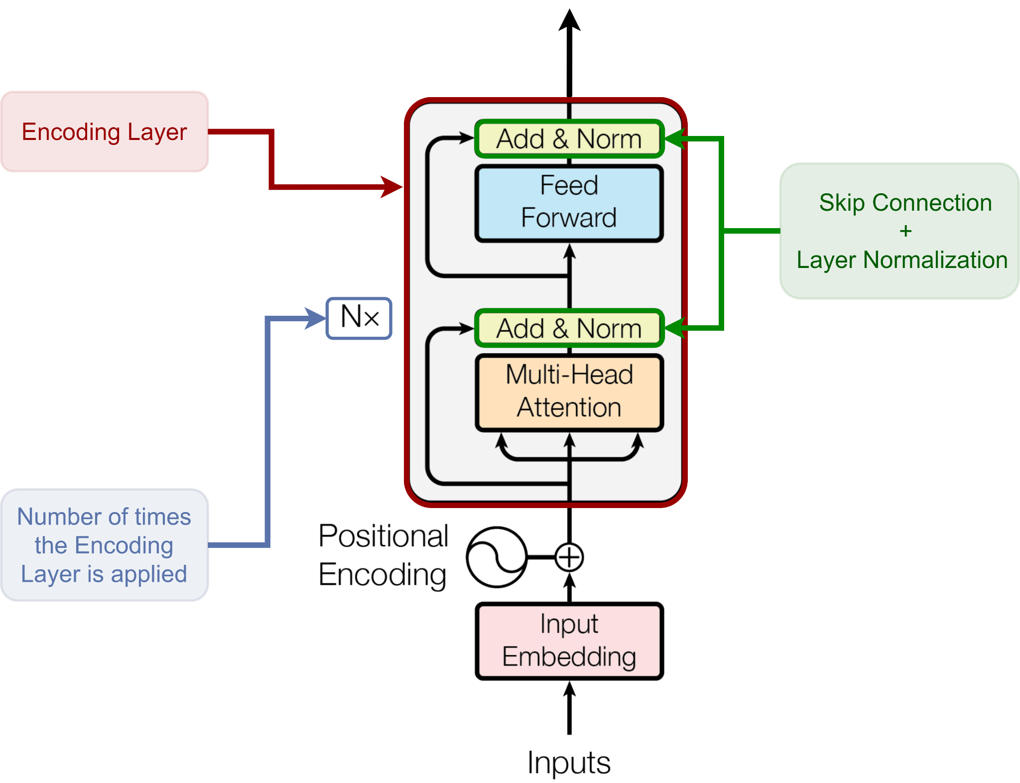
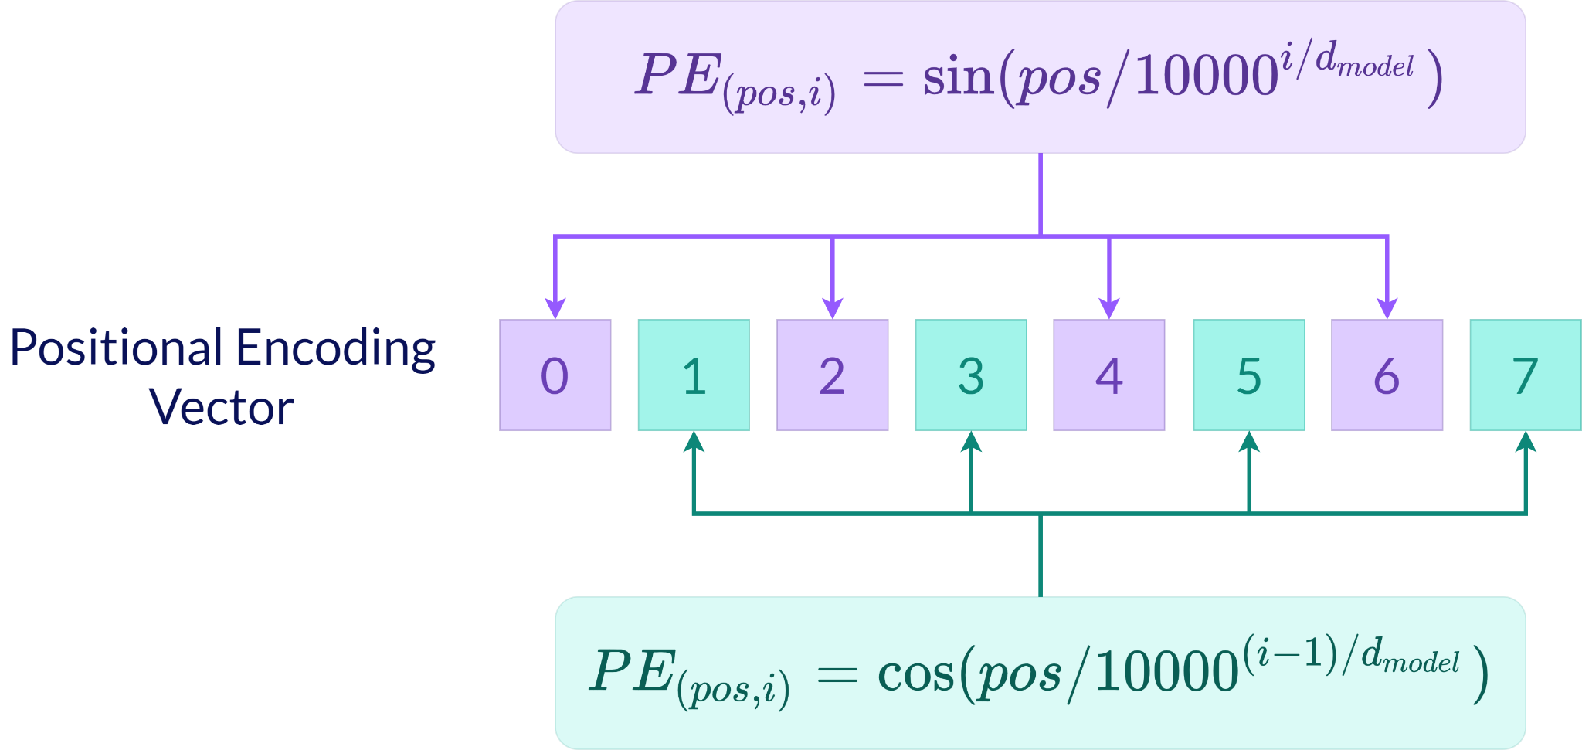
4. Transformers: Encoder
C) Encoder Architecture Attention is all you need (Vaswani et al 2017)
A) Encoding Layer
B) Input Embedding

Slide 18
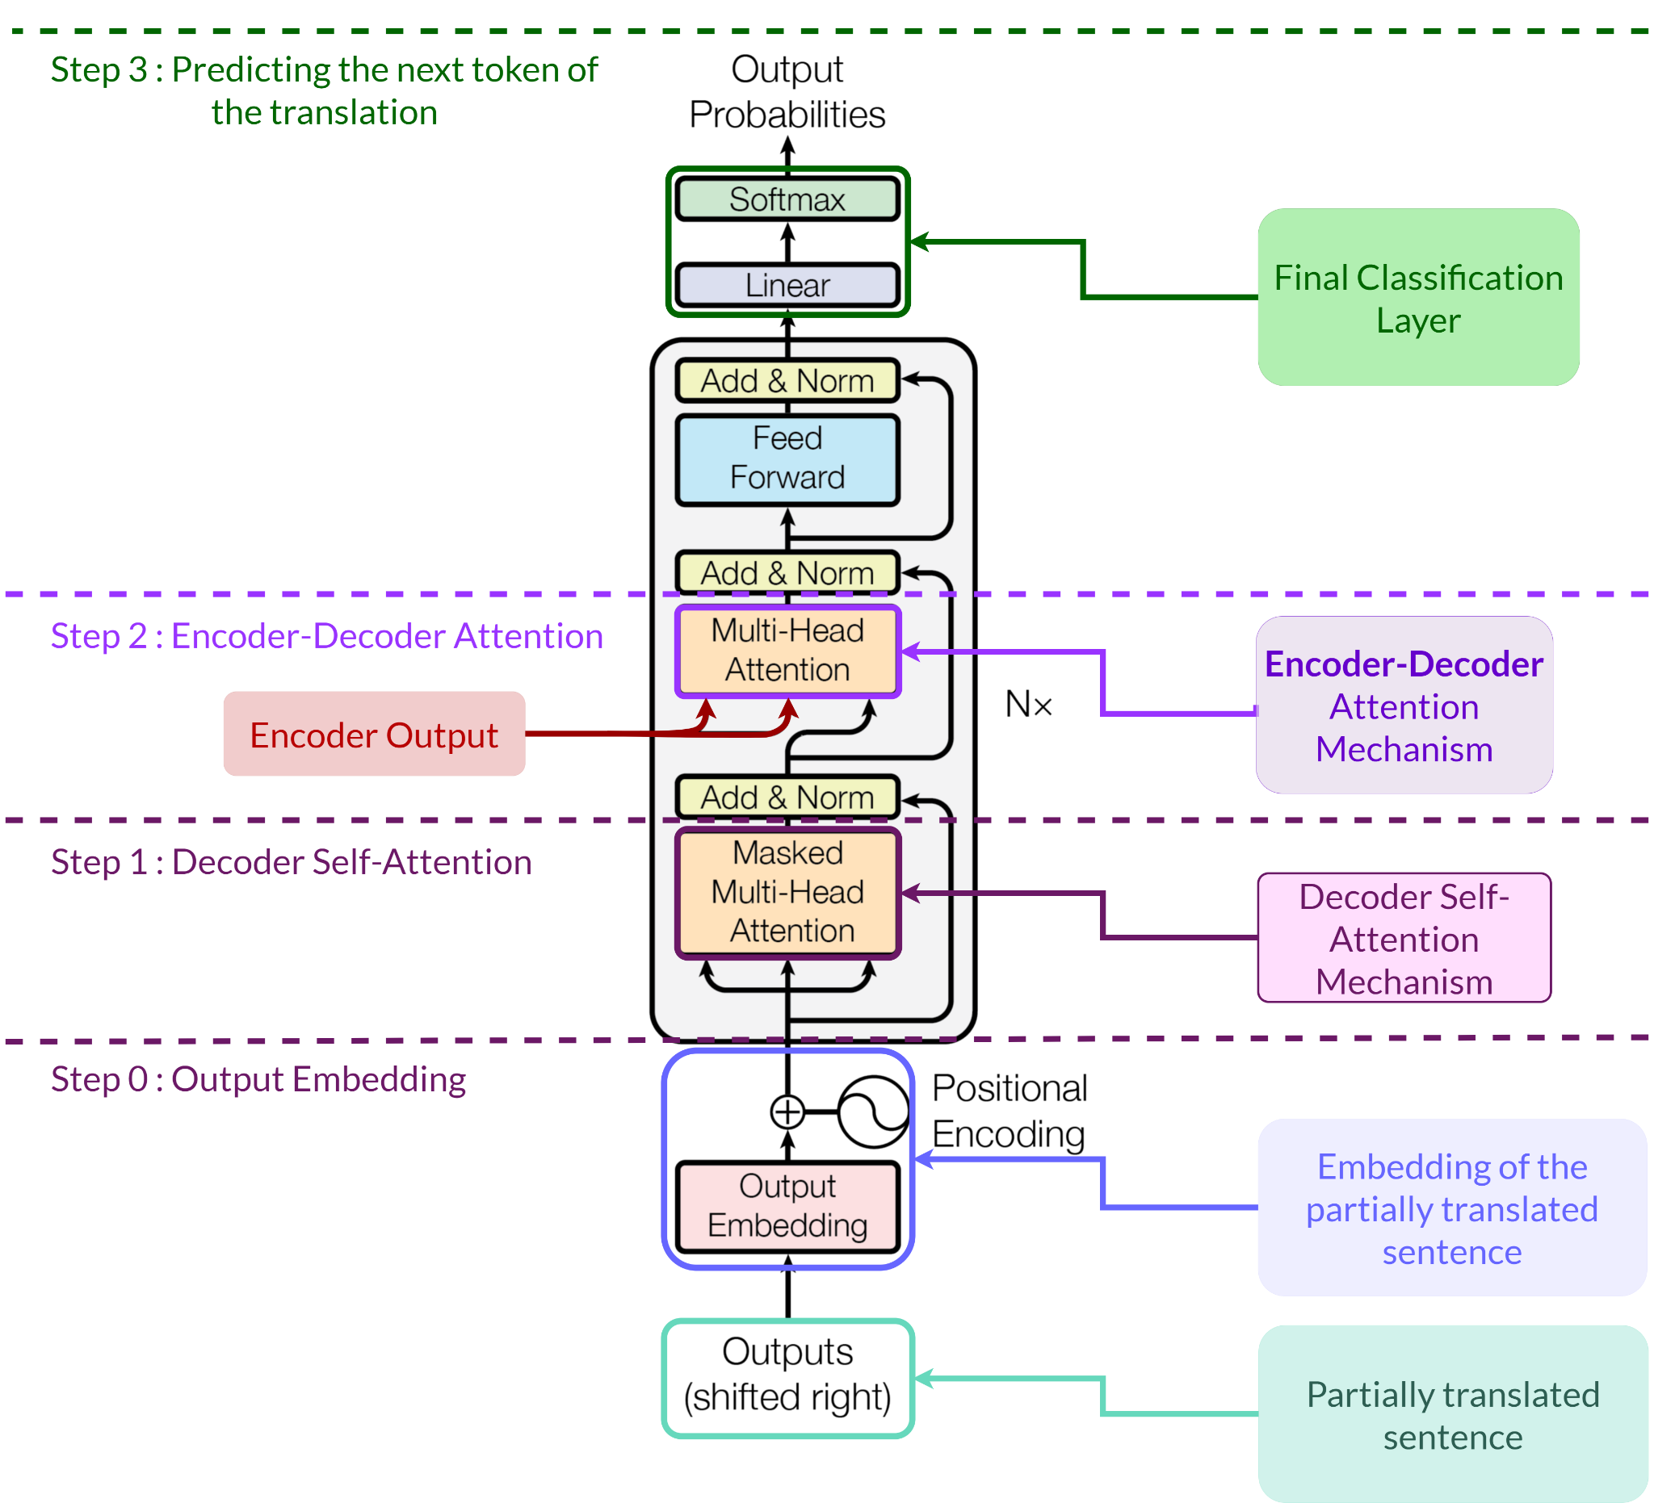
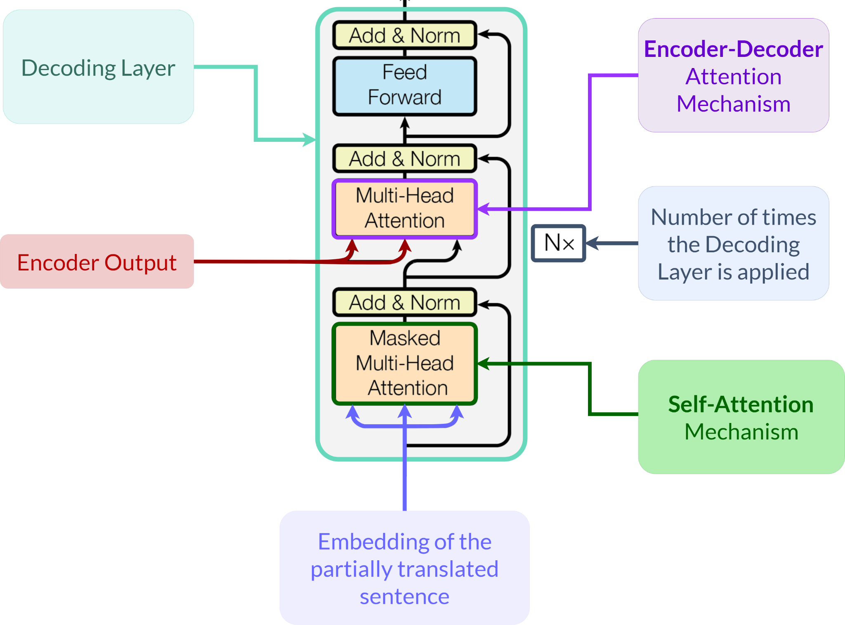
4. Transformers Decoder
A) Decoding Layer
B) Decoder Architecture

Slide 19
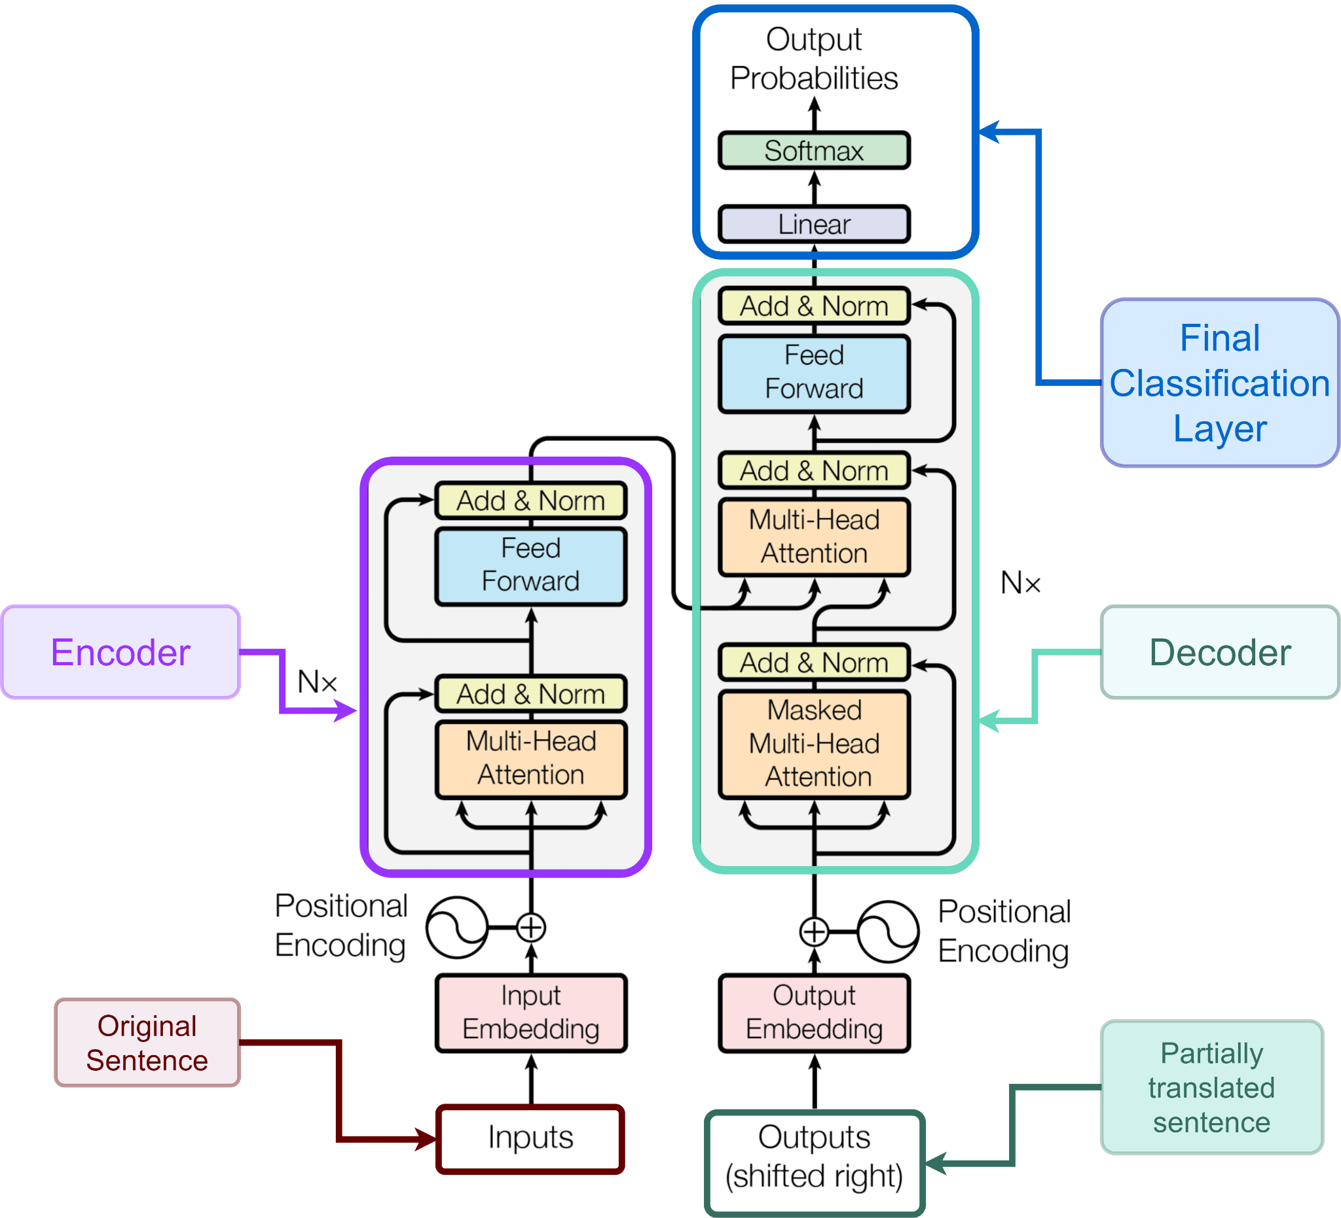
4. Transformer

Slide 20
Applications and openings:
Improvements
Beam Search in the Seq2Seq modelisation Selecting the k most probable translations
Language Models (post treatment techniques for Speech Recognition articles in the appendix of the final report)
Openings
Apply our translation system to the VoiceGlass prototype Broaden the spectrum of action of the VoiceGlass project
Word Separation context Segregate voices and apply speech recognition system in a social setting
Improvements

Slide 21

Acknowledgments
IASD Faculty Members, especially: Mr. Tristan Cazenave Mr. Benjamin Negrevergne
CTO of DataScientest.com and internship supervisor: Mr. Charles Sutton
The DataScientest team, especially:
Mr. Thomas Boehler
Mr. Pierre Adaikalam

